Slide 1


Ufff !! I can’t hear..
But…shouldn’t I drive because of that ??

Slide 2


MAKE DEAF TO DRIVE

Slide 3

PRESENTERS
NIVETHA M B P KARISHMA M FINAL YEAR IT VELAMMAL COLLEGE OF ENGG & TECH

Slide 4

PROBLEM STATEMENT
The speech and hearing impaired people may wish to drive motorcycles as a normal person. But they are impotent to drive due to hearing impairment; as a consequence driving license is also not permitted.

Slide 5
SOLUTION
We have pitched an idea to design a Smart Helmet which sense the horn and alert the hearing impaired person in the form of vibration.
When such helmet is designed, the hearing impaired people can drive. Since the license is not permitted to them, they can drive e-scooty. With this Smart Helmet, they get benefitted to drive independently.

Slide 6
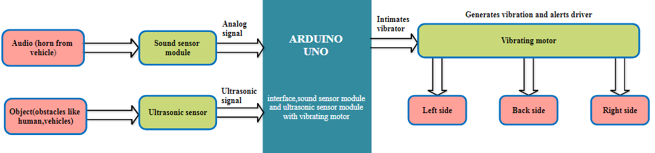
WHAT WE PLANNED?

Slide 7
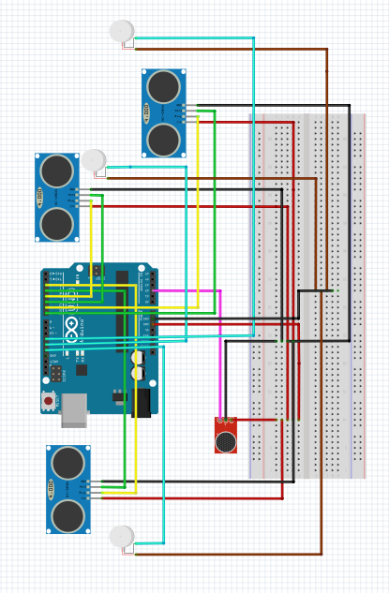
CIRCUIT DIAGRAM

Slide 8
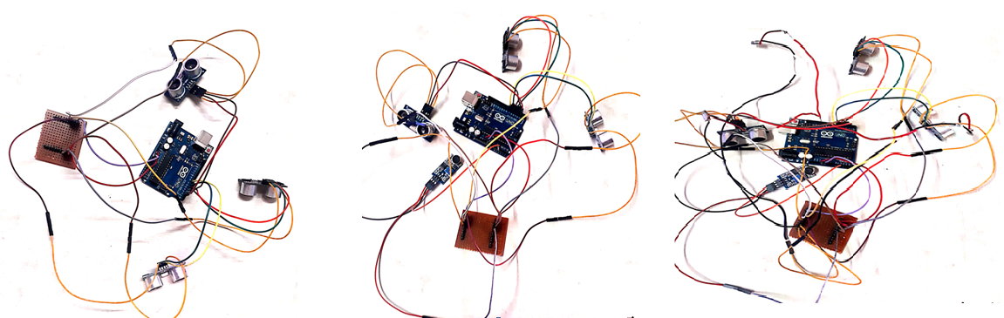
STEPS IN CONSTRUCTION
Step 1: Connect all three ultrasonic sensors.
Step 2: Connect the sound sensor module.
Step 3: Connect all three vibrators.

Slide 9
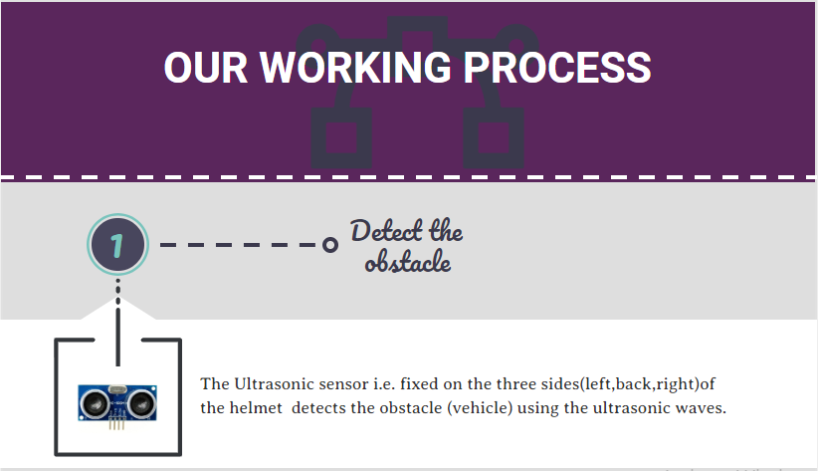
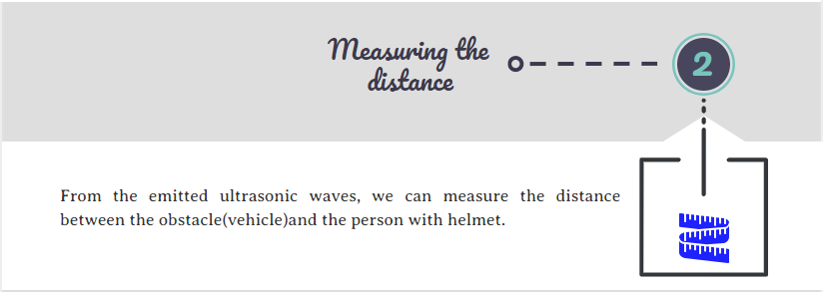

Slide 10
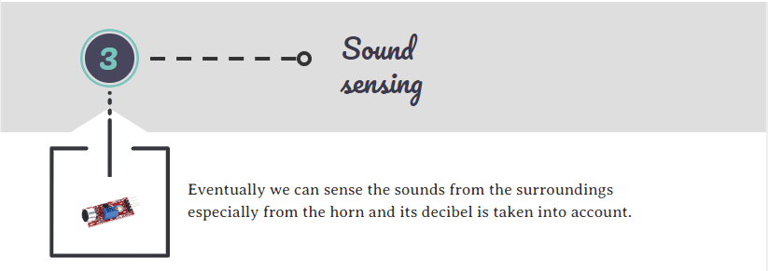
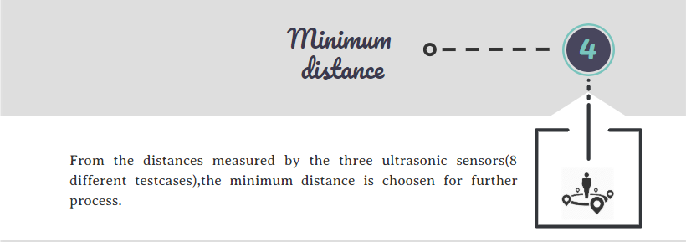
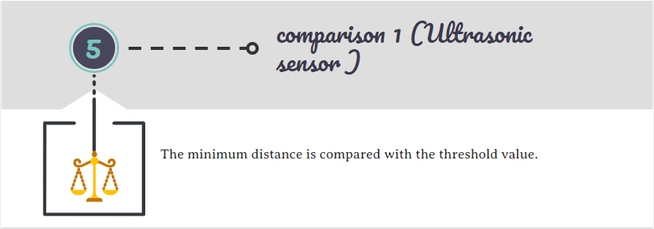

Slide 11
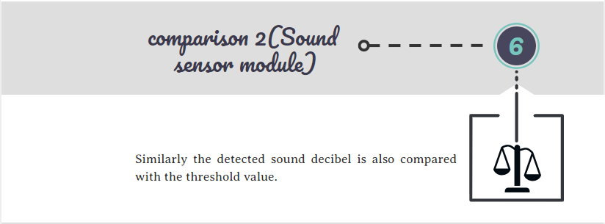
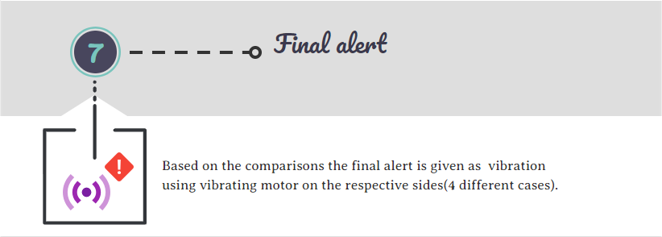

Slide 12
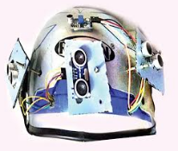
FINAL PROTOTYPE
SOUND
SENSOR
ULTRASONIC
SENSOR

Slide 13
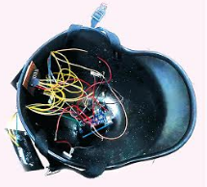
INNER VIEW OF PROTOTYPE

Slide 14
RESEARCHES DONE
Health Related research
The vibration that alerts the hearing impaired person is in the safe range as suggested by the doctor.
Research to set threshold limits
Threshold value for sensing sound and distance was experimented and tested to create various test cases.

Slide 15
TEST CASES
Test cases | Ultrasonic sensor1 (Left) Output (in cms) | Ultrasonic sensor 2 (Back) Output (in cms) | Ultrasonic sensor 3 (Right) Output (in cms) | Compare the distance(d) measured & find direction & d_{min} (in cms)
Test case 1 | 100 | 150 | 170 | 100 (Left)
Test case 2 | 150 | 100 | 170 | 100 (Back)
Test case 3 | 170 | 150 | 100 | 100 (Right)
Test case 4 | 100 | 100 | 100 | 100 (Back)
Test case 5 | 100 | 100 | 150 | 100 (Back)
Test case 6 | 100 | 100 | 90 | 90 (Right)
Test case 7 | 100 | 150 | 100 | 100 (Right)
Test case 8 | 100 | 50 | 100 | 50 (Right)

Slide 16

THRESHOLD COMPARISON
Sound threshold >Ts=800 | Ultrasonic value <Tu=200 | Output
400 | 100 | High
850 | 100 | High
850 | 250 | Low
600 | 250 | Low

Slide 17

FUTURE ENHANCEMENT

Slide 18


Slide 19
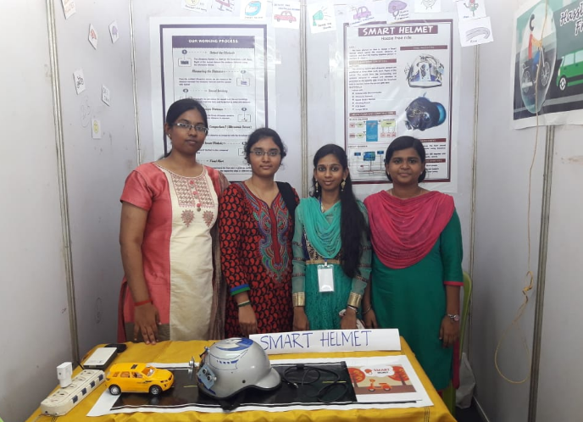
Exhibiting our project in National Level Project Contest
at Saintgit’s Engineering College, Kerala and recognized as Top 10 Project.
Demonstration of our project
https://www.youtube.com/watch?v=Ura30iEriD4

Slide 20


